Slide 1
Battleships
By Nathan, Caspian, & Tazkia

Slide 2
Battleship is fun
Seemed challenging
Easy to break into parts
Requires playtesting
Utilizes Matrices
Why?

Slide 3
How it works:
Rules
Ship placement
Rock, paper, scissors to determine the first shooter
Player shooting
Smart AI shooting

Slide 4

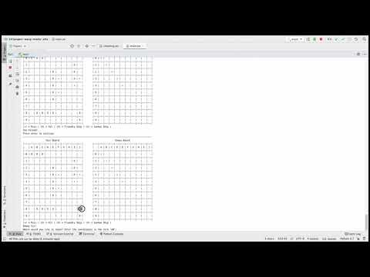
Demonstration

Slide 5
Things We Used
List
Ships
Allows ordered placement
Targets
Keeps track of damaged ships
Matrix
Boards
Allows simple display for player board and enemy board
Dictionary
Ship locations
Allows us to easily check sunken ships
Player Input
Reference dictionary to “read” player input

Slide 6
Challenges
Smart AI shooting
Shooting intelligently without “cheating”
Detecting when to turn around and shoot the other way
Shooting out of bounds
Shooting adjacent ships
Placement
Discouraging adjacent placement
Recording ship locations
Sink and Win Detection
Printing results (converting X’s to V’s) instantaneously
GUI
Hiding enemy ships from the player

Slide 7
Thank you!

